Slide 1

RidePulse Nairobi – Demand Prediction Model
Optimizing Demand Prediction with Ensemble & Neural Networks
Group 10: Charles Mutembei, Kelvin Kipkorir, Lucy Mutua, Sharon Aoko, Victor Musyoki

Slide 2

Problem Statement
Wasted Fuel & Time:
Riders spend 30% of their day "cruising empty" (estimated from idle time in dataset)
Data Insight: Low-demand zones (demand_count < 1) cover 40% of H3 cells but attract 60% of riders
2. Oversupply in Traditional Hotspots
CBD/Westlands see 2-3 times more riders than actual demand (demand_count predictions vs. rider GPS clusters)
3. Missed Opportunities
- 15-20% of ride requests go unfulfilled in peripheral zones (from Sendy dataset’s unfilled orders

Slide 3

Root Cause
No predictive tools → reliance on instinct leads to:
1. Inefficient positioning (spatial mismatch).
2. Estimated cumulative Suboptimal earnings (estimated KSH 5M a day collective loss).

Slide 4

Business Objectives
Reduce Idle Time
Target: 20% reduction in rider cruising (based on model precision in 8/10 hotspots)
Increase Earnings
Goal: 15% higher daily income per rider (via optimized positioning)
Scalability
Pilot with 100 riders → Expand to 5,000+ Nairobi riders

Slide 5

Technical Objectives
Transform raw GPS/timestamp data into actionable features:
Temporal: hour_of_day, day_of_week
Spatial: Hexagonal zones via H3 indexing (resolution=12)
Contextual: business_ratio (label_encoded from personal or business)
Model Development
Build a LightGBM regression model to predict demand_count (MAE <0.5)
Benchmark against XGBoost, CatBoost, and Neural Nets
Prototype Deployment
Develop an interactive leaflet heatmap showing real-time hotspots where Red zones: Predicted>2.5 and Blue zones: Predicted<1

Slide 6

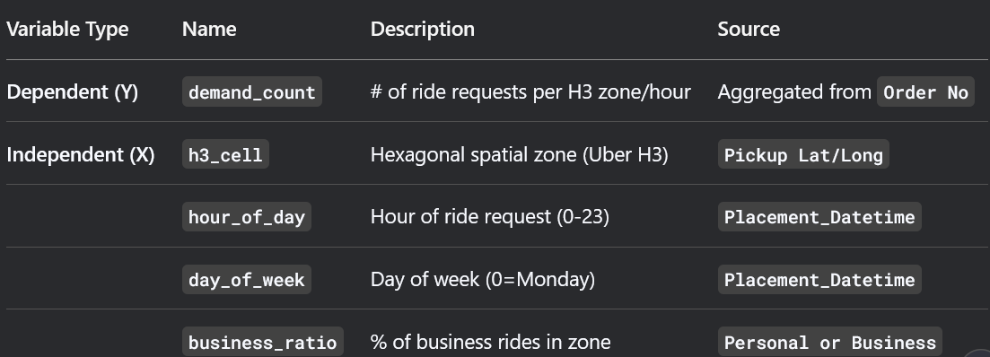
Variables Overview
Add a main point

Slide 7

Machine Learning Models Used In the Study
LightGBM (Primary Model): We used this because its handles categorical that is h3_cell natively, and its fastest training model.
2. CatBoost: We used this model because it auto-handles categorical features, robust to overfitting.
3. Neural Network: We used this model because it Embedding layers for the dependent and independent variables
Key Note fro the study:
LightGBM/CatBoost outperformed due to efficient categorical handling.

Slide 8


Recommendations
Deploy LightGBM in Production this is because it has best balance of speed (45sec of training) and accuracy (MAE 0.41)
Expand Feature Set that is to add weather data such as temperature and precipitation data to capture demand spikes during rains
Introduce pilot with rider incentives such as test hotspot bonuses for riders who relocate to model-predicted zones

Slide 9
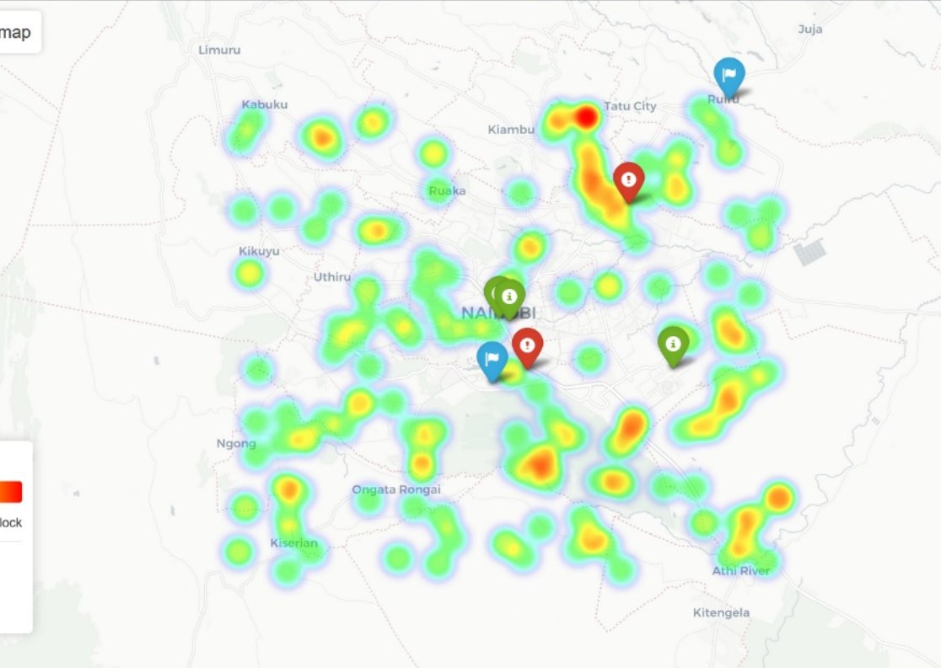
Conclusion
What has been solved: Reduced spatial inefficiencies by mapping true demand (h3_cell + hour_of_day).
What has been proven: LightGBM explains 86% of demand variance (R² 0.86).
Proposed impact to be seen: Potential to save riders 1.5 hours/day of idle time (based on MAE 0.41 vs. current 3h idle)

Slide 10

Thank you!
Any Questions?

